Slide 1
Improving Real Estate Portfolio’s Returns - Finding Investment Opportunities in Ames Housing Property Market
16th July 2021
Valuation Team
Adriel Chen, Ash Ang, Estebelle Khong & Timothy Chan

Slide 2
Agenda
Introduction
Problem definition
Data preparation, engineering and analysis
Model selection and evaluation
Recommendation and conclusion
Introduction &
Problem Definition
Data Preparation &
Engineering
Modelling, Selection
& Evaluation
Recommendation & Conclusion

Slide 3
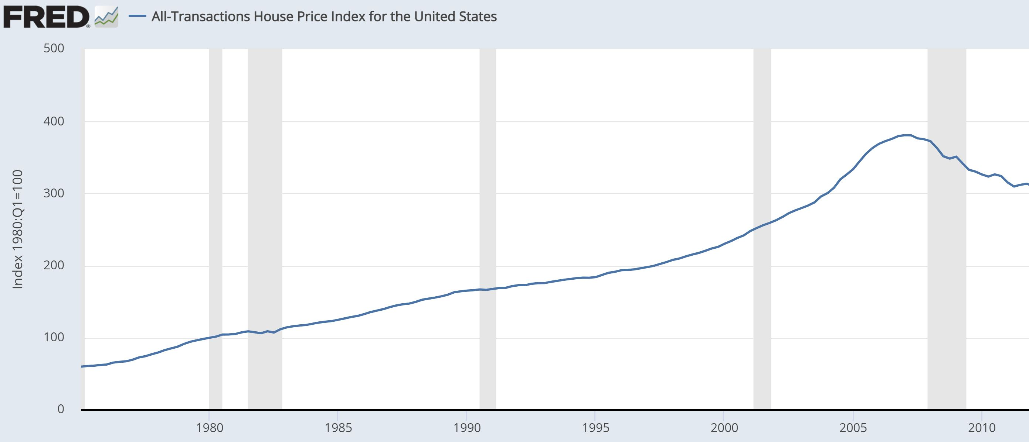
Dampening effect of 2008 Global Financial Crisis extends into recovery period
2008 Start of Global Financial Crisis
House Price Index for the U.S. is a weighted, repeat-sales index, meaning that it measures average price changes in repeat sales or refinancing on the same properties in 363 metropolises.
Source: https://fred.stlouisfed.org/series/USSTHPI
Introduction &
Problem Definition
Data Preparation &
Engineering
Modelling, Selection
& Evaluation
Recommendation & Conclusion

Slide 4
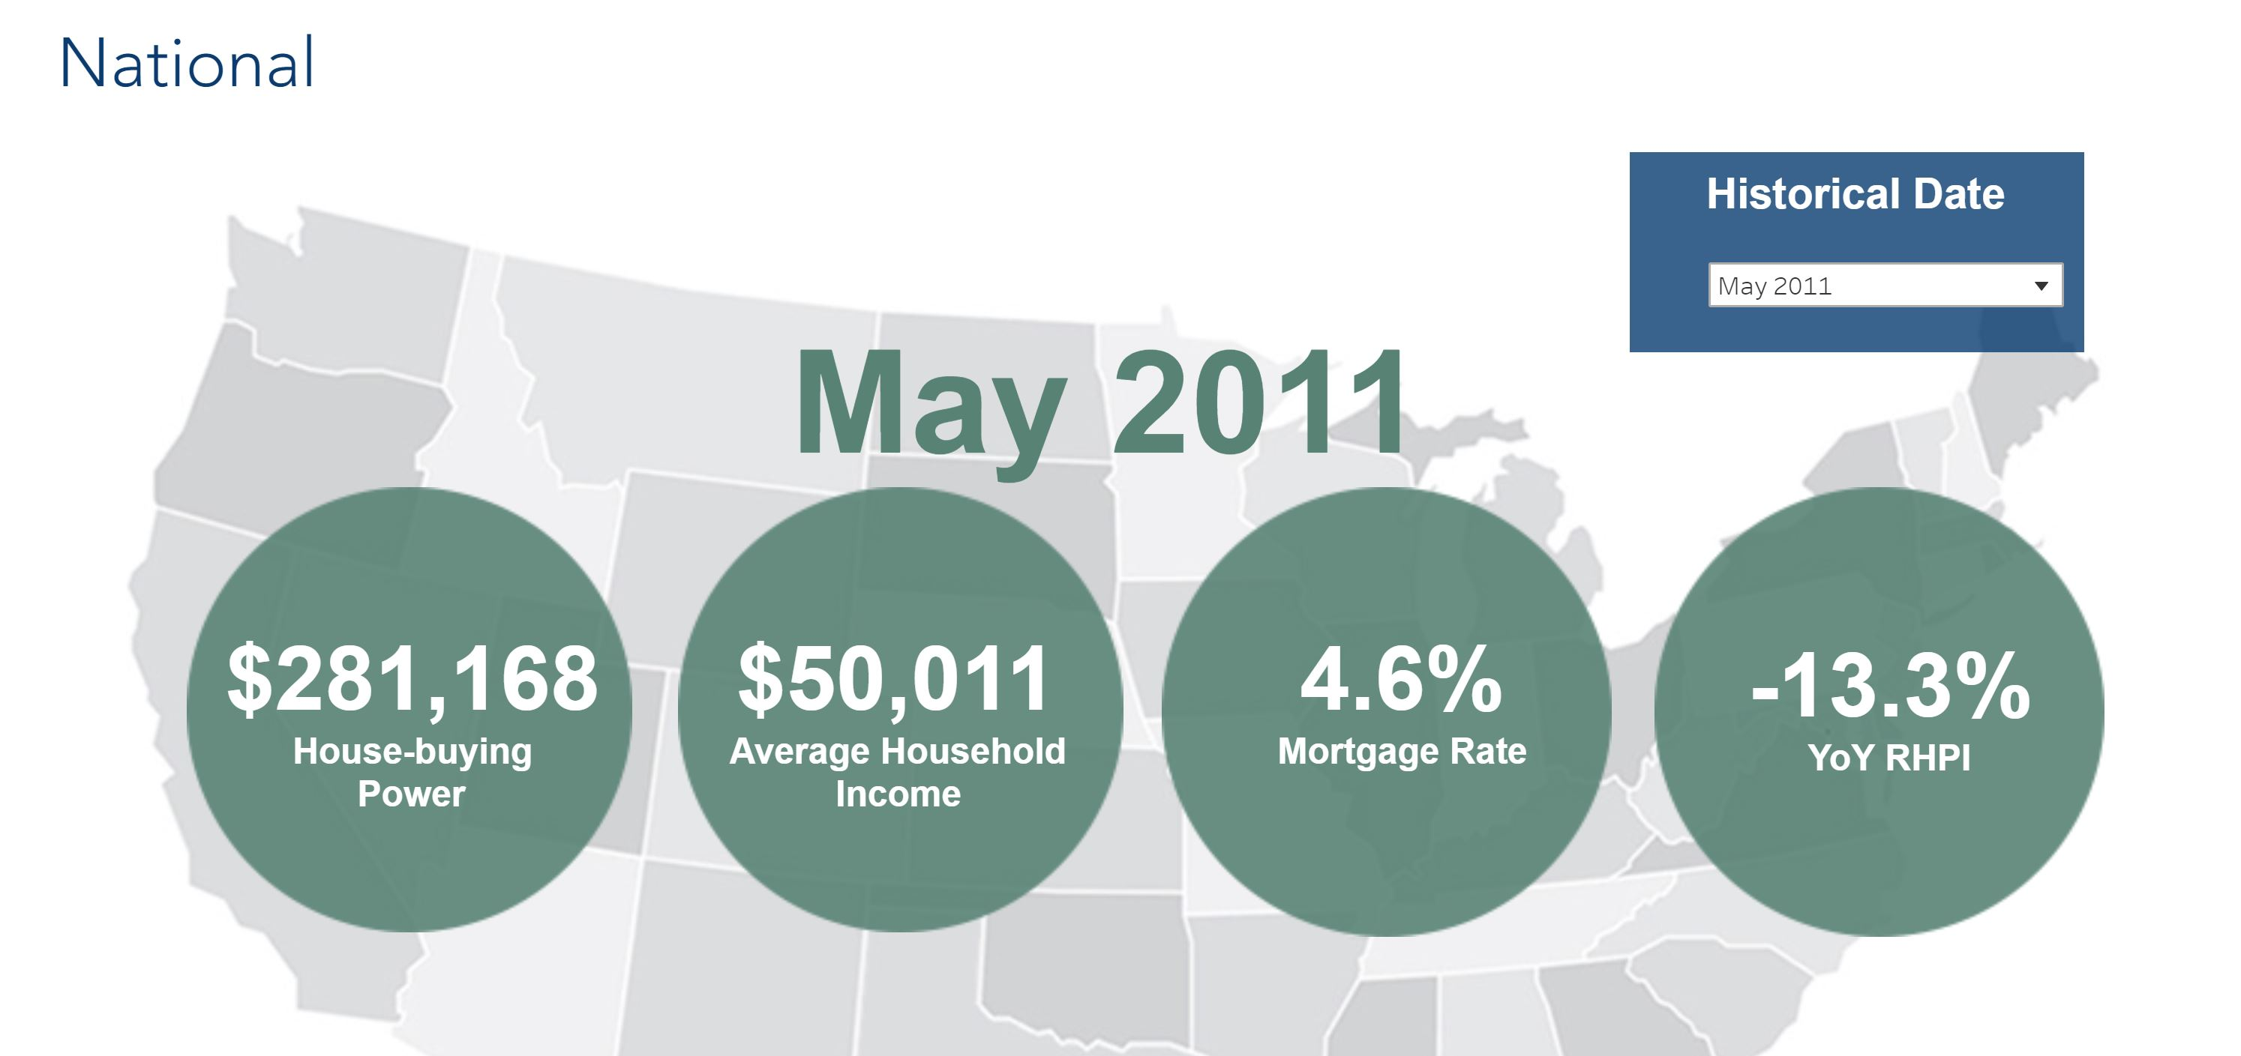
Snapshot of U.S. Housing Market
RHPI - Real House Price Index measures the price changes of single-family properties throughout the U.S. adjusted for the impact of income and interest rate changes on consumer house-buying power over time and across the United States at the national, state and metropolitan area level.
Source: https://www.firstam.com/economics/real-house-price-index/
Introduction &
Problem Definition
Data Preparation &
Engineering
Modelling, Selection
& Evaluation
Recommendation & Conclusion

Slide 5
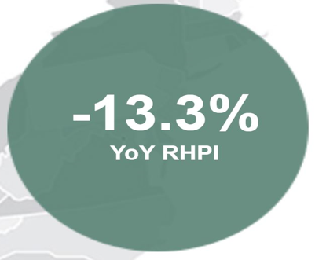
Dismal performance of company’s real estate portfolio
- 15.9 %
Company’s adjusted
YoY real estate portfolio returns
RHPI - Real House Price Index measures the price changes of single-family properties throughout the U.S. adjusted for the impact of income and interest rate changes on consumer house-buying power over time and across the United States at the national, state and metropolitan area level.
Introduction &
Problem Definition
Data Preparation &
Engineering
Modelling, Selection
& Evaluation
Recommendation & Conclusion

Slide 6
Objectives
Create a regression model to accurately predict Ames residential property sale price
Introduction &
Problem Definition
Data Preparation &
Engineering
Modelling, Selection
& Evaluation
Recommendation & Conclusion

Slide 7

What is Regression Analysis?
Input
Output
F1
F4
Outcome
variable
F2
F5
F3

Slide 8
Motivations for using Regression Analysis
Traditional
Statistical
Common methods include, sales comparison approach, cost approach and income approach
Useful to some extent
Subjected to human biases such as confirmation and selection bias
Regression analysis or other more advanced techniques
Flexible and works well with large dataset
More objective and reduce human bias and errors
Allows us to study relationships of independent variables and dependent variable on deeper level
Introduction &
Problem Definition
Data Preparation &
Engineering
Modelling, Selection
& Evaluation
Recommendation & Conclusion

Slide 9
Objectives
Create a regression model to accurately predict residential property sale price by reducing the incidences of human biases and errors,
Study how influential independent variables are in accounting for variation in sale price in the selected model,
Use it to guide buy/sell/hold recommendations and adjust real estate investment portfolio to maximize returns for shareholders and,
Make recommendations on how model can be fine-tuned with new data.
Introduction &
Problem Definition
Data Preparation &
Engineering
Modelling, Selection
& Evaluation
Recommendation & Conclusion

Slide 10
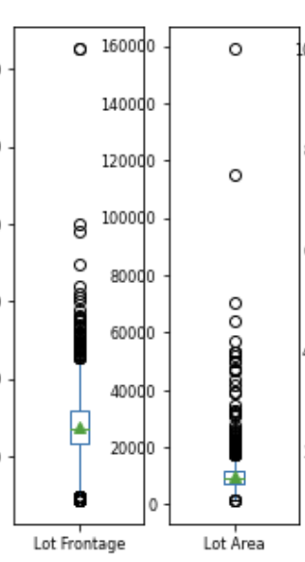

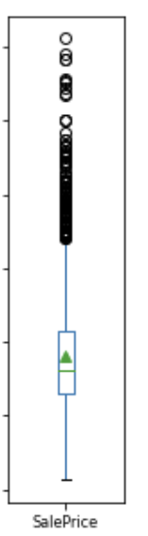



Data Preparation
Extreme outliers, about 1% of the sample, are removed.
2,390
Samples
Collected by Ames Assessor’s Office, containing information of individual residential properties sold in Ames, IA.
Non-residential properties (less than 1% records) are removed from the sample.
Year 2006 --------------------- > 2010
Introduction &
Problem Definition
Data Preparation &
Engineering
Modelling, Selection
& Evaluation
Recommendation & Conclusion

Slide 11

There are about 80 features available for evaluation.
Correlation analysis was conducted among all the features, including our target Sale Price.
The features covered:
Year built,
Zoning, Street,
Lot area/shape,
Neighbourhood,
Quality of house/building,
Living area,
Kitchen,
Garage,
Basement,
Other additional features.
Any 2 independent features that are highly correlated (>70%), one of which is removed to minimize interference to the prediction model.
There are about 16 pairs.
Introduction &
Problem Definition
Data Preparation &
Engineering
Modelling, Selection
& Evaluation
Recommendation & Conclusion

Slide 12
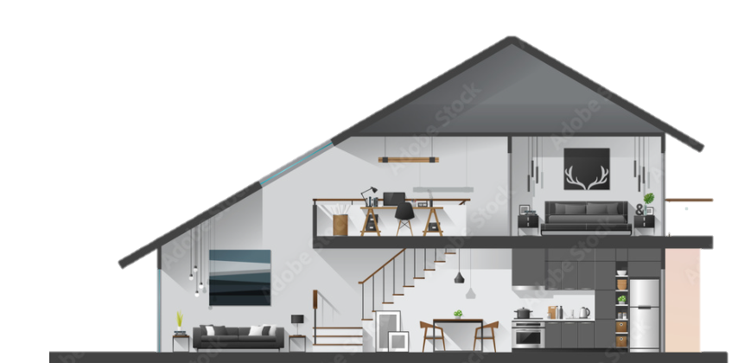
Exploratory Data Analysis (EDA)
Features strongly correlate with Sale Price
Year Built
Overall Quality
Exterior Quality
Garage Quality
Sale Price
Basement Quality/ Size
Kitchen
Living Area
Legend:
80% correlated
70% correlated
60% correlated
Introduction &
Problem Definition
Data Preparation &
Engineering
Modelling, Selection
& Evaluation
Recommendation & Conclusion

Slide 13
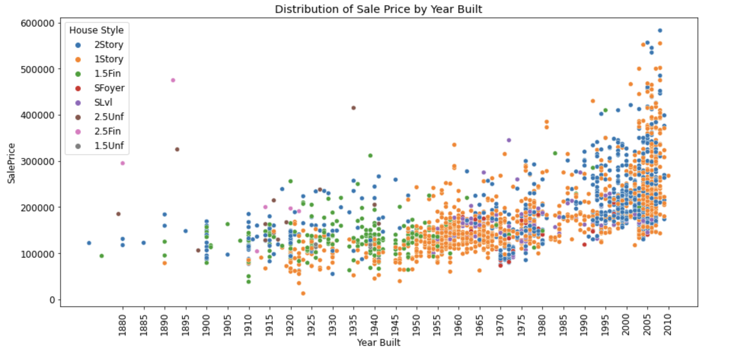
Sale volume is more promising if the built-year is more current. Respectively, the sale price generally climbs if the age of unit is younger.
Recent housing style are majority 1 storey and 2 storeys.
Introduction &
Problem Definition
Data Preparation &
Engineering
Modelling, Selection
& Evaluation
Recommendation & Conclusion

Slide 14
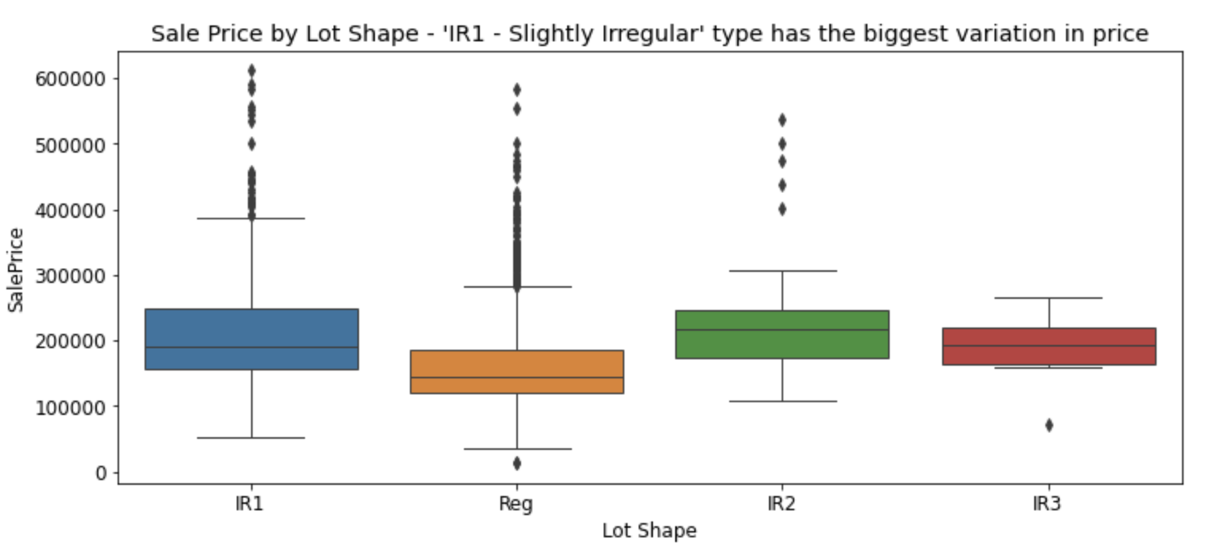
‘Regular’ and ‘Slightly Irregular’ house type made up almost 97% of the lot shapes.
Both display a larger lower and upper range, with noticeable outlier cluster.
Introduction &
Problem Definition
Data Preparation &
Engineering
Modelling, Selection
& Evaluation
Recommendation & Conclusion

Slide 15
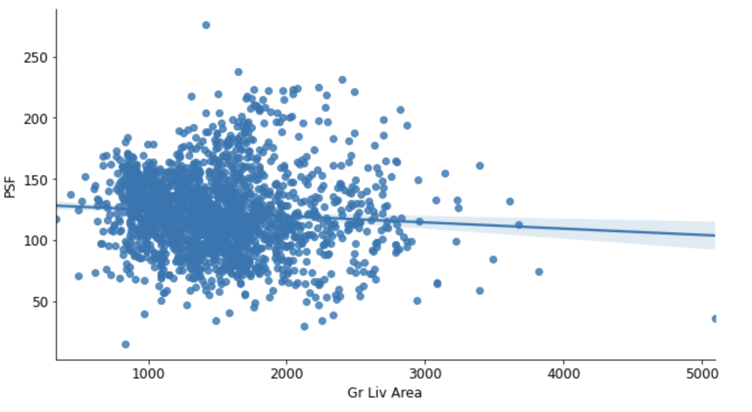
Price-per-square-foot (PSF) has a negative linear relationship with ground living area. This relationship is valid because the bigger the house plan, all other things being equal, the cost can be spread over the square-feet. This is an important feature to consider in the model as it has direct impact on price.
Introduction &
Problem Definition
Data Preparation &
Engineering
Modelling, Selection
& Evaluation
Recommendation & Conclusion

Slide 16
Model Workflow
Gather, prepare and partition the data
Train/Test Split
On the dataset, we performed a 70:30 - Train/Test Split
Machine learning models used
Linear Regression
Ridge Regression
LASSO Regression
Introduction &
Problem Definition
Data Preparation &
Engineering
Modelling, Selection
& Evaluation
Recommendation & Conclusion

Slide 17
Evaluation and model selection
 | Baseline Model (Null) | Linear Regression | Ridge Regression | LASSO Regression
R^2 Train Score | 0 | 0.939 | 0.940 | 0.943
CV R^2 Train Score | NA | -7.753e+25 | 0.934 | 0.940
R^2 Test Score |  | -1.079e+23 | 0.853 | 0.822
Diff of CV Train Score & Test Score |  |  | 0.081 | 0.118
RMSE | 68,353 |  | 19,713 | 19,869
Ridge Regression is the best performing model
Ridge Regression Model has a smaller difference than Lasso Regression for the R^2 CV Train and Test score
With lower RMSE, Ridge Regression will provide better predictions of Sale Price than the Null Model
Introduction &
Problem Definition
Data Preparation &
Engineering
Modelling, Selection
& Evaluation
Recommendation & Conclusion

Slide 18
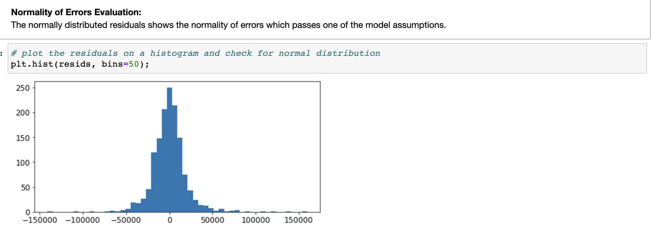
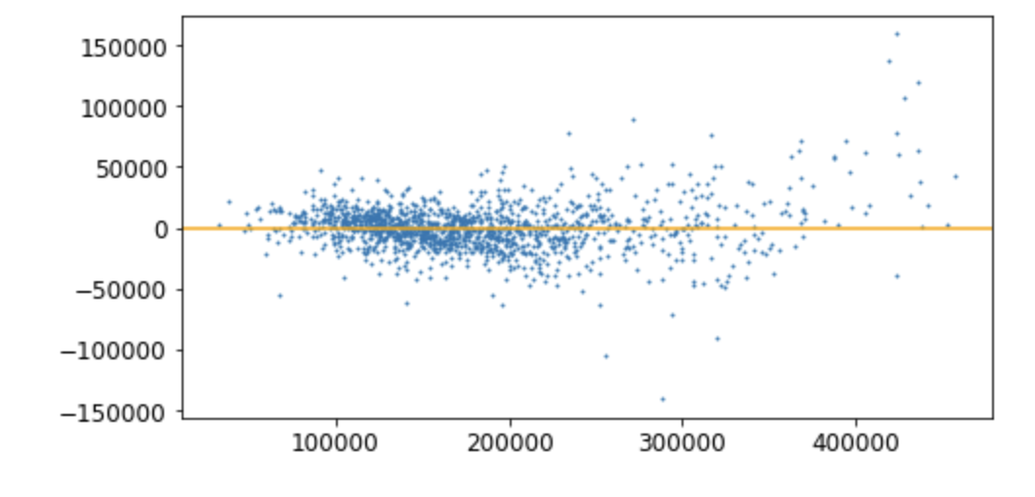
Evaluation of Ridge Regression
Distribution of Residuals
Scatter Plot of Sale Price & Residuals
Count Of Residuals
Residuals
Residuals
Sale Price
From the above plots, the model satisfies the 4 assumptions of LINE.
L - There is a linear relationship.
I - The errors are independent.
N - The errors are normally distributed.
E - There is an equal variance of errors.
Introduction &
Problem Definition
Data Preparation &
Engineering
Modelling, Selection
& Evaluation
Recommendation & Conclusion

Slide 19
Model Workflow
Get predictions using the Ridge Regression Model
R^2 score for the dataset and the predicted sale price is 0.934.
The score means that 93.4% of the variability in the predicted price is explained by the features in our model.
This implies that the model would be very effective in predicting the sale price of a property.
Introduction &
Problem Definition
Data Preparation &
Engineering
Modelling, Selection
& Evaluation
Recommendation & Conclusion

Slide 20

Conclusion & Recommendations
98
93.4
%
Production Ready
Accuracy
Introduction &
Problem Definition
Data Preparation &
Engineering
Modelling, Selection
& Evaluation
Conclusion & Recommendation

Slide 21
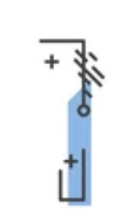
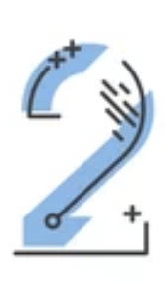

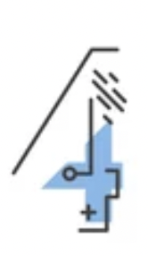

Conclusion & Recommendations
Above Ground (Grade) Living Area
Total Basement Area
Overall Quality
Basement Height
Garage Size
Purchase Price < Predicted Price | BUY
Purchase Price > Predicted Price | DON’T BUY
Sell Price > Predicted Price | SELL
Sell Price < Predicted Price | HOLD
Introduction &
Problem Definition
Data Preparation &
Engineering
Modelling, Selection
& Evaluation
Conclusion & Recommendation

Slide 22



Going forward
Implementing this model in other towns
Identify new features for finetuning
Gather data about rental statistics
Introduction &
Problem Definition
Data Preparation &
Engineering
Modelling, Selection
& Evaluation
Conclusion & Recommendation

Slide 23

Going forward
MOBILE APP
RECOMMENDATION
Automation
+ Scraping
GUIDE
MONTHLY REPORT
Introduction &
Problem Definition
Data Preparation &
Engineering
Modelling, Selection
& Evaluation
Conclusion & Recommendation

Slide 24
Q&A

